Slide 1
NEURAL HACK SEASON 6 Blossoms Red
TEAM OUTBREAKERS
Vansh Gupta
Raghavendar Cherlagudem
Swetha Kakumanu
Ruchitha Bandaru
Yogindra Addanki

Slide 2
ABSTRACT
The business to consumer aspect of electronic commerce (e-commerce) is the most visible business use of the Word Wide Web. Unlike traditional commerce that is carried out physically with effort of a person to go & get products, ecommerce has made it easier for human to reduce physical work and to save time. The primary goal of an e-commerce site is to sell goods and services online. This project is a web based shopping system for bouquets.

Slide 3
PROBLEM STATEMENT
The main of the project is
To build an application that customers can access and purchase bouquet online.
To have a provision to maintain a database for customer information , order information and product portfolio.

Slide 4
FUNCTIONAL REQUIREMENTS
Signup , login , profile , dashboard page, and product page.
Provision to maintain a database for customer information, order information and product portfolio.
Integrated platform required for admin and customer.
To include options for adding / modifying / removing the existing products and customer management.

Slide 5
LANGUAGES AND LIBRARIES
ReactJs (Java script library)
Node Js
Express Js
MongoDB
HTML5
CSS3

Slide 6
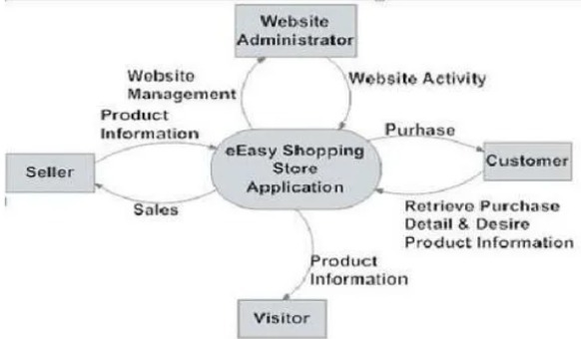
DATA FLOW DIAGRAM

Slide 7
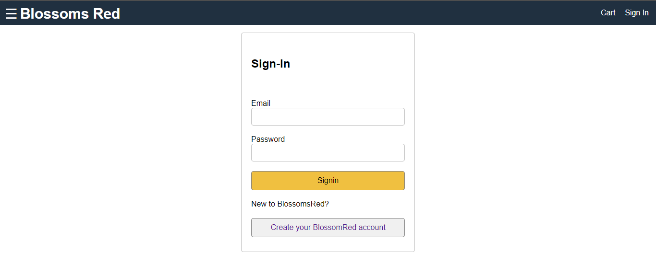
IMPLEMENTATION AND OUTPUTS
SIGNIN PAGE:

Slide 8
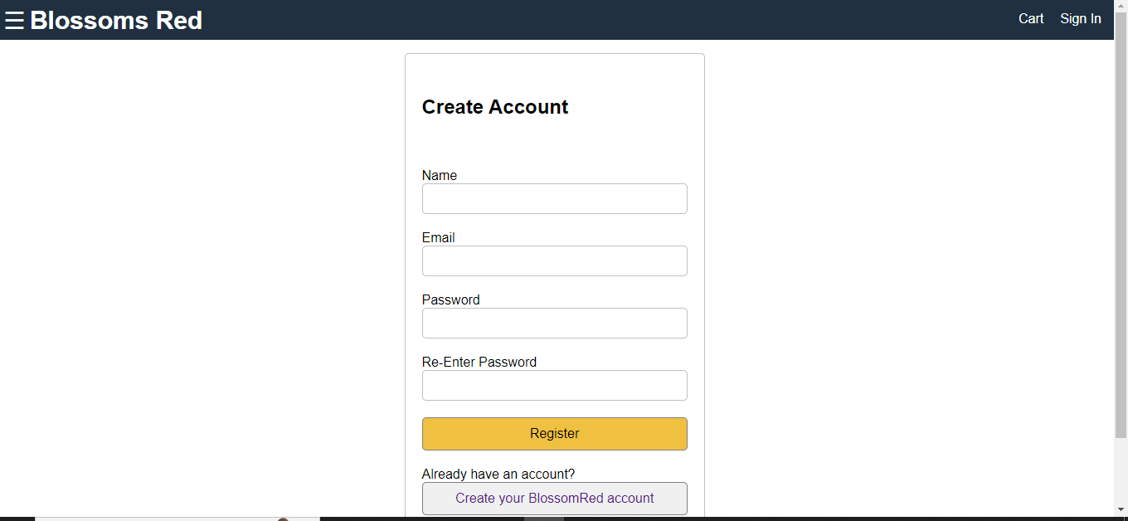
REGISTER PAGE:

Slide 9
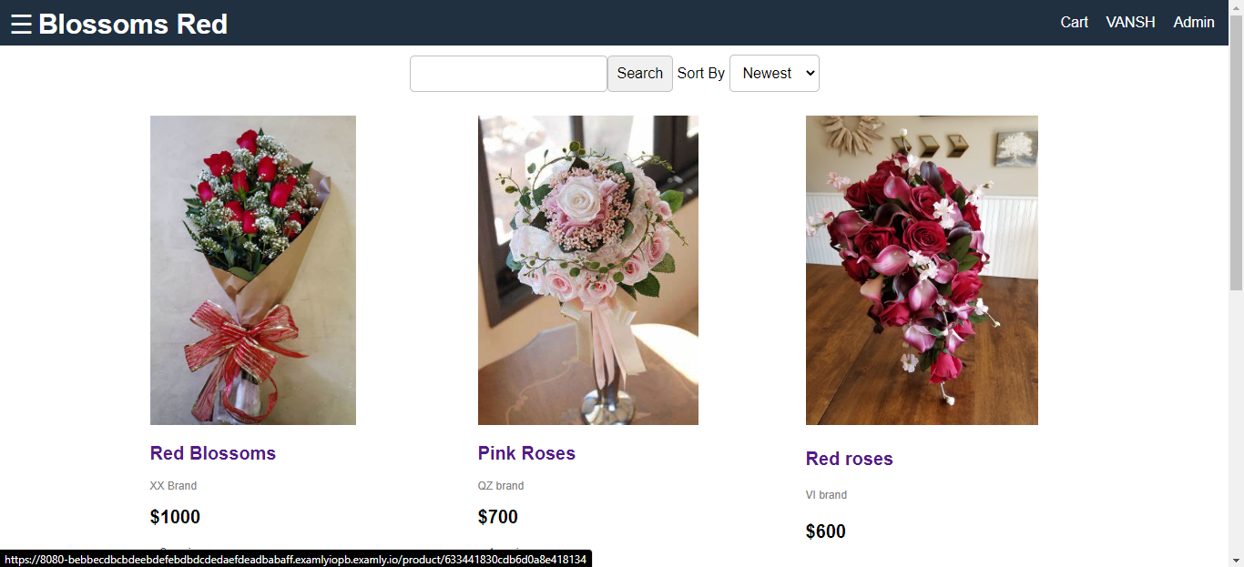
PRODUCT LIST:

Slide 10
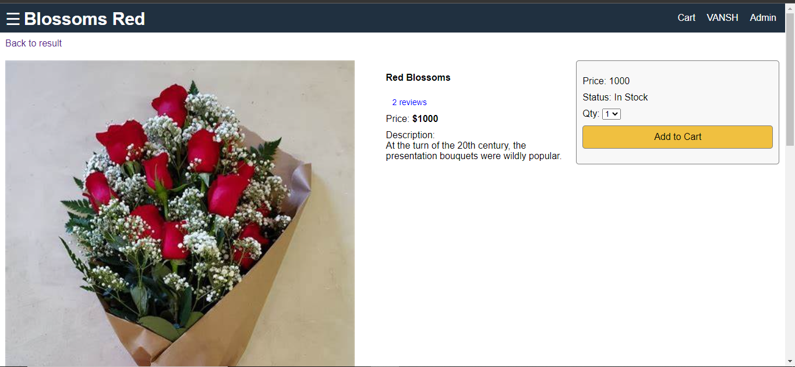
PRODUCT DISPLAY:

Slide 11
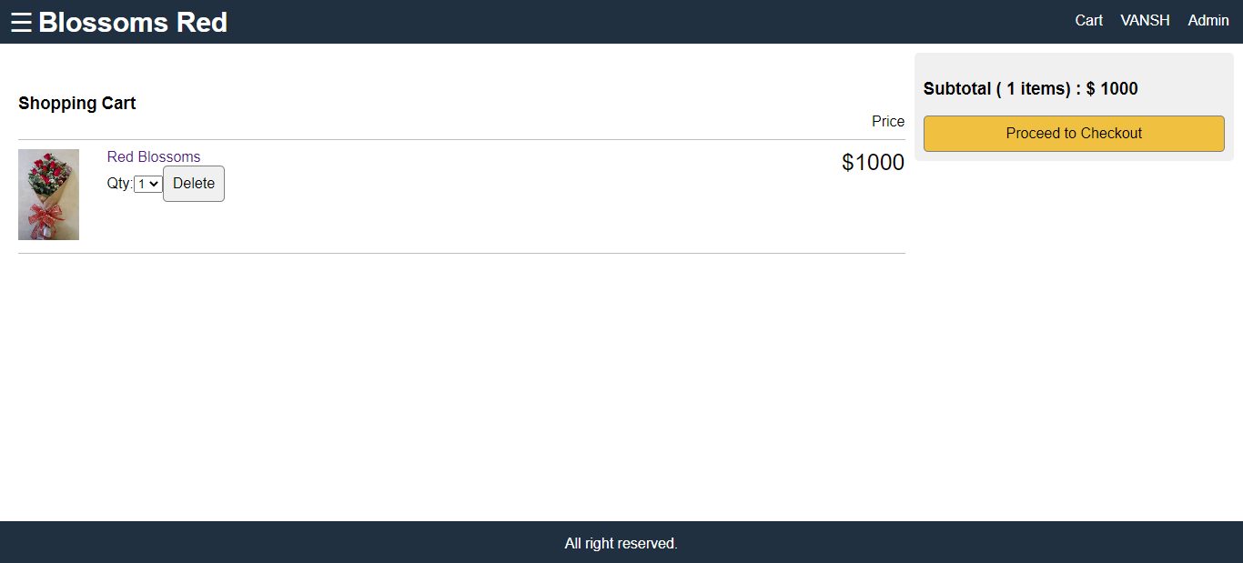
CARD DISPLAY:

Slide 12
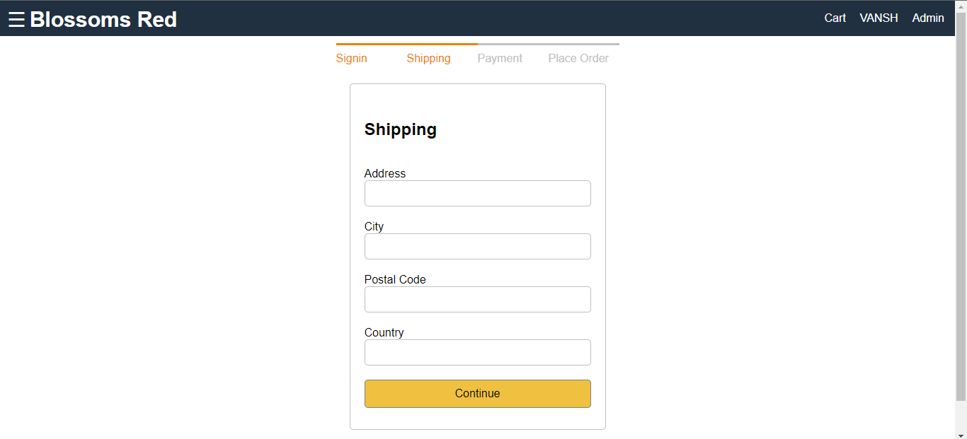
Shipping Address:

Slide 13
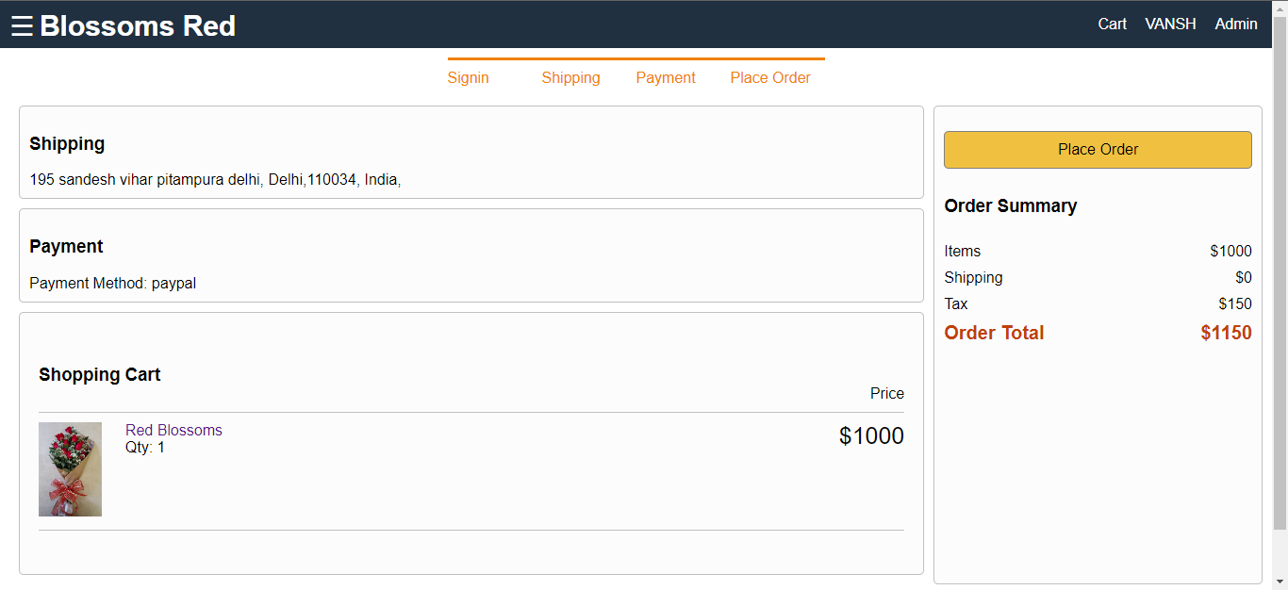
ORDER PLACEMENT:

Slide 14
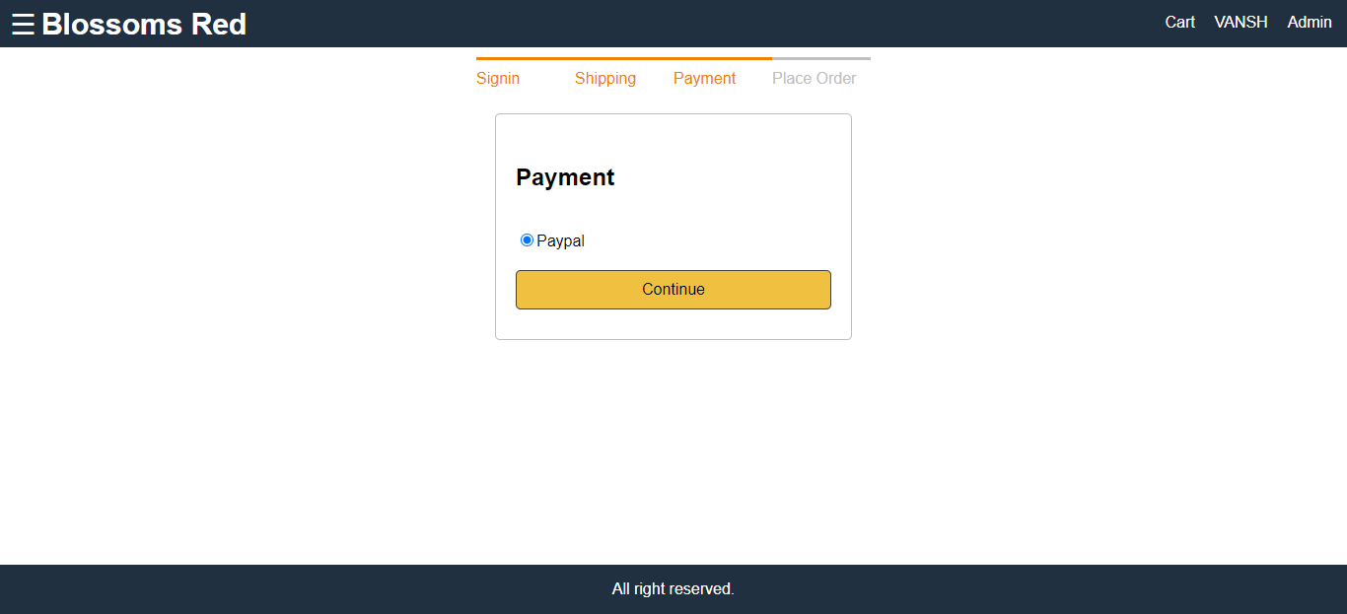
PAYMENT:

Slide 15
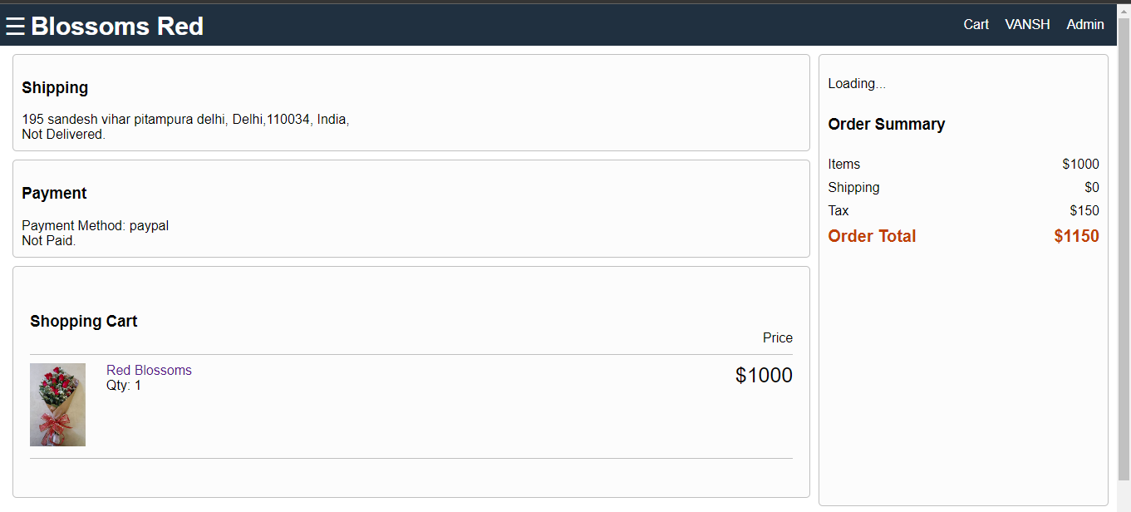
ORDER SUMMARY:

Slide 16
Thank You

